Slide 1

Spark Core
Justin Pihony
@JustinPihony | justin-pihony.blogspot.com
Notes:
NEXT: Maintainers

Slide 2




Spark Core
Maintainers
Matei Zaharia
Reynold Xin
Patrick Wendell
Josh Rosen
Notes:
Matei
Reynold
Patrick
Josh
NEXT: Agenda, where we’re at

Slide 3
Agenda
Basics of Spark
Core API
Cluster Managers
Spark Maintenance
Libraries
SQL
Streaming
MLlib/GraphX
Troubleshooting / Optimization
Future of Spark
Notes:
NEXT: Core API Expose

Slide 4
Agenda
Core API
Appify
RDD
Transforming Data
Action!
KeyValue
Cache
Accumulator
Java
Basics of Spark
Core API
Cluster Managers
Spark Maintenance
Libraries
SQL
Streaming
MLlib/GraphX
Troubleshooting / Optimization
Future of Spark
Core API
Notes:
Appify
RDD
Transformations
Action
Paired Objects
Cache
Accumulator
Java
NEXT: Mechanics of Spark

Slide 5
Spark Mechanics
Driver
Worker
Worker
Worker
Notes:
Central Manager
Coordinates work across distribution
NEXT: Spark Context drives it all

Slide 6
Spark Mechanics
Driver
Spark Context
Driver
Worker
Worker
Worker
Notes:
NEXT: Spark Context is like the conductor

Slide 7

Spark Context
Task creator
Scheduler
Data locality
Fault tolerance
Notes:
Builds execution graph
Schedules the work when acted
Data locality
Fault monitoring
NEXT: Code

Slide 8
Let’s build a program!
Notes:
NEXT: RDD

Slide 9
RDD
…collection of elements partitioned across the nodes of the cluster that can be operated on in parallel…
https://spark.apache.org/docs/latest/programming-guide.html#overview
Notes:
(core abstraction)
Quoted definition
NEXT: But what is it really?

Slide 10


RDD
Resilient Distributed Dataset
DAG
Transformations
map
filter
…
Actions
collect
count
reduce
…
Notes:
Resilient Dist Dataset
Simply a collection
Distributed behind the scenes
Failures don’t require full rebuilds
Uncircle
Lazy cat
DAG
Transformations
Map – Filter – Etc
Action cat
Collect – count – reduce – etc
NEXT: With better understanding – back to high level pic

Slide 11
Spark Mechanics
Driver
Spark Context
Worker
Worker
Worker
Worker
Worker
Worker
Notes:
(While seems collection)
Really distributed
NEXT: to be executed in parallel

Slide 12
Spark Mechanics
Driver
Spark Context
Worker
Worker
Worker
Executor
Executor
Executor
Notes:
(whether across CPU's, machines, or both)
(Driver application is just like any other application)
NEXT: Until an action

Slide 13
Spark Mechanics
Driver
Spark Context
Task
Task
Task
Task
Task
Task
Task
Worker
Worker
Worker
Executor
Executor
Executor
Notes:
Driver and context distribute task
Which transform respective datasets
(After all tasks done can trigger next part of DAG until completed)
If before complete a chunk is lost
Scheduler finds a new node
And restarts transformation only as far as needed until in sync
NEXT: So, where does the INITIAL data come from?

Slide 14


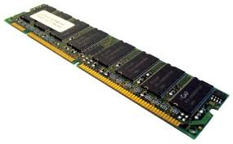



Input
HDFS
S3
Notes:
(numerous possibilities)
File system (as seen)
Distributed ones: HDFS - Amazon S3 (hdfs:// or s3n://)
Databases
Distributed ones again: Cassandra
Load from memory if can fit from start
(Numerous file formats)
Parquet – Avro, and more
NEXT: Load in code

Slide 15
Let’s load some data!
Notes:
NEXT: Before digging any further, SUPER QUICK Lambda review

Slide 16
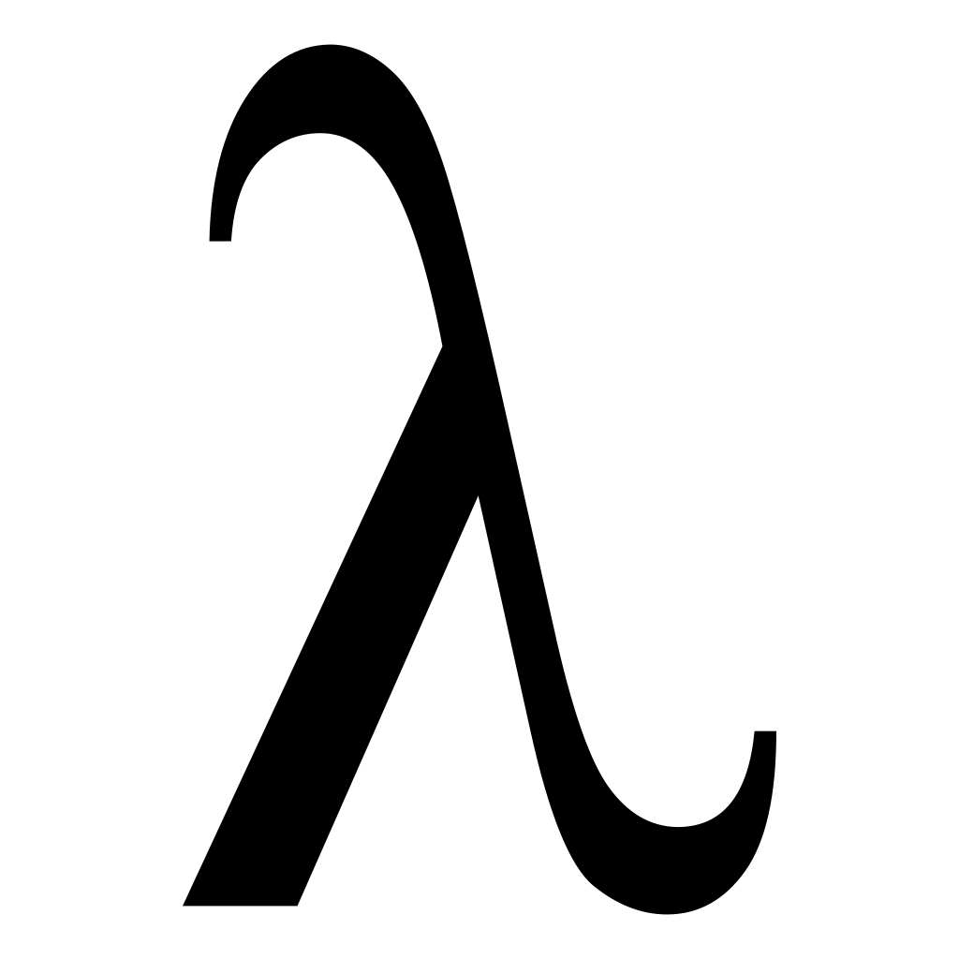
rdd.flatMap(line => line.split(" "))
Notes:
(Before digging any further, SUPER QUICK Lambda review)
Already used in a number of places
Flatmap’s line goes to line split on space
NEXT: Start w/ what everybody knows = Named Methods

Slide 17
Named Method
def addOne(item: Int) = {
item + 1
}
val intList = List(1,2)
for(item <- intList) yield {
addOne(item)
}
for(item <- intList) yield {
addOne(item)
}//List(2,3)
Notes:
As here, AddOne is an incrementer (note scala final statement is return)
Given a number list
Using for loop, run each through our addOne method
Yields a new incremented list
NEXT: Let’s rewrite as a lambda

Slide 18
Lambda Functions
Named Method
def addOne(item: Int) = {
item + 1
}
val intList = List(1,2)
intList.map(x => {
addOne(x)
})
intList.map(x => {
addOne(x)
})//List(2,3)
Notes:
Same addOne method
Same starting list
Same transformation using list’s map method
(same as for-comp earlier, each integer is MAPPED through the addOne)
Same output
NEXT: Lambda allows for even cleaner code

Slide 19
Lambda Functions
val intList = List(1,2)
intList.map(item => item + 1)//List(2,3)
intList.map(item => item + 1)
Notes:
Can inline instead of delegating to addOne
STILL same result
NEXT: Slide up (Take concise lambda to see a one to one comparison)

Slide 20
Lambda Functions
val intList = List(1,2)
intList.map(item => item + 1)//List(2,3)
Notes:
NEXT: Original named method code

Slide 21
Lambda Functions
val intList = List(1,2)
intList.map(item => item + 1)//List(2,3)
def addOne(item: Int) = {
item + 1
}
val intList = List(1,2)
for(item <- intList) yield {
addOne(item)
}//List(2,3)
Notes:
Left side of lambda is param list for function
Same as method param list
So, right side of lambda
Same as method code block
(Simplified view of functional code block)
(Usage depends on method it’s provided to)
Map iterates through each item, applying function, output new list
Just as manual iteration
NOTE: Scala allows multiline, but Python does not
NEXT: Now let’s use all this to explore RDD Transformations

Slide 22
Transformations
transform(
)
Notes:
(Remember 2 method types: Transformations & Actions)
(Trans is as sounds)
Takes dataset
Runs through provided function
Transforms into another shape
NOTE: Method is Trans if return type is RDD
NEXT: Learn through code

Slide 23
Let’s learn by example!
Notes:
NEXT: More transforms, visualized this time

Slide 24
map
Node1
Node2
NodeN
for(item <-items) {
yield mapFunction(item)
}
for(item <-items) {
yield mapFunction(item)
}
for(item <-items) {
yield mapFunction(item)
}
Notes:
Data is distributed right?
Map function runs for EACH item
Repeated – Across each node’s dataset
(Cases where is inefficient – Database Connection/Repeated similar object = High GC)
NEXT: mapPartitions

Slide 25
mapPartitions
(glom)
Node1
Node2
NodeN
mapItemsFunction(items)
mapItemsFunction(items)
mapItemsFunction(items)
Notes:
Takes a different approach
Accepts different type of mapping function
Which takes full dataset as an iterator
Return transformed iterator while full control during trans
Just as before – Process repeated for each partition
Glom returns RDD[Array[U]] was predecessor at memory cost., so use mapParts
NEXT: Trans that combine RDDs in some way

Slide 26


RDD Combiners
RDD1
RDD2
HDFS
Notes:
Suppose one source is from MongoDB
Other is HDFS
NEXT: RDD is generalized abstraction, so Union together via Union method

Slide 27
RDD Combiners
RDD1
union
RDD2
RDD1.union(RDD2)
HDFS
combinedRDD
Notes:
Merges so can treat as though from central location
(Not distinct though, follow up with distinct op)
(Aliased as ++, or SC.union if more than two RDD)
NEXT: Back to our 2 RDD, intersection method

Slide 28
RDD Combiners
RDD1
RDD1.intersection(RDD2)
RDD2
intersection
Notes:
Combines the two RDD again
NEXT: Except only the objects that are equal between two RDD

Slide 29
RDD Combiners
RDD1.intersection(RDD2)
Notes:
(Except only the objects that are equal between two RDD)
NEXT: Distinct this time = duplicates in RDDs dropped, even if multiple matches

Slide 30
RDD Combiners
intersectedRDD
RDD1.intersection(RDD2)
Notes:
(Distinct this time = duplicates in RDDs dropped, even if multiple matches)
NEXT: Subtract method

Slide 31
RDD Combiners
RDD1
RDD1.subtract(RDD2)
RDD2
subtract
subtractedRDD
Notes:
Combine again; ONLY unique values from calling RDD
NEXT: 2nd to last is cartesian

Slide 32
RDD Combiners
RDD1
cartesian
RDD2
RDD1.cartesian(RDD2)
1
A
2
B
3
4
C
…
…
Notes:
Combines each item to each ala a double for loop
(Not possible via a map with 2nd RDD inside of that…can’t use RDD inside at all)
Pairing happens for each item to each of the other items
NEXT: Gets cumbersome

Slide 33
RDD Combiners
RDD1.cartesian(RDD2)
NxMRDD
1
A
2
A
3
A
4
A
…
A
1
B
2
B
3
B
4
B
…
B
1
C
2
C
3
C
4
C
…
C
1
…
2
…
3
…
4
…
…
…
Notes:
(Results in new RDD of all possible element pairs)
NxM sized
NEXT: Now, zip

Slide 34
RDD Combiners
RDD1
zip
RDD2
RDD1.zip(RDD2)
1
A
2
B
3
C
…
…
Notes:
Requires both RDDs have same # partitions AND elements inside
Reason: each item across dist needs a pair or will have dangling reference
NEXT: combined into same sized RDD

Slide 35
RDD Combiners
RDD1.zip(RDD2)
zippedRDD
1
A
2
B
3
C
…
…
Notes:
(Difficult to guarantee, but other zips: zipWithIndex/zipWithUniqueId)
(Acts on single RDD)
(Few other transformations, but this is majority)
NEXT: On to Actions

Slide 36
Actions
Driver
Spark Context
Worker
Worker
Worker
Executor
Executor
Executor
Notes:
(Can load/manipulate, now want DO something with it)
Transformations lazy and keep distributed as much as possible
Actions can result in data sent back to the driver
(Thus return type is NOT RDD)
NEXT: Some actions keep distributed as long as possible

Slide 37
Actions
Driver
Spark Context
Worker
Worker
Worker
Executor
Executor
Executor
Notes:
(Some actions keep distributed as long as possible)
Only sending a subset of data back
(Performance gains – minimizes network)
(ie. Word count w/ million of same instances)
(mapside combine means only send one instance w/ count per partition & merge)
NEXT: Distributed merge only works if function associative

Slide 38
Associative Property
2 + 4 + 4 + 7
Notes:
(Distributed merge only works if function associative)
Quick review using addition (associative)
(Simple example can add up in one go)
NEXT: OR, divide into chunks (as if distributed)

Slide 39
Associative Property
(2 + 4) + (4 + 7)
Notes:
(OR, divide into chunks (as if distributed))
(Associative = No matter division, same results)
Let’s see this in action
NEXT: Add up first group

Slide 40
Associative Property
(2 + 4) + (4 + 7)
6
+
11
17
Notes:
(Add up first group)
Set aside to add other group
Add subtotals
Gives final result
NEXT: Keep that in mind while adding same numbers again

Slide 41
Associative Property
(2 + 4) + (4 + 7)
6
+
11
17
Notes:
(Keep that in mind while adding same numbers again)
NEXT: Just clustered differently

Slide 42
Associative Property
(2 + 4) + (4 + 7)
(2 + 4 + 4) + 7
6
+
11
10
+
7
17
17
Notes:
(We said addition is assoc so should yield same results)
Again add first group
Then next
Add groups to get results
NEXT: AND…..

Slide 43
Associative Property
(2 + 4) + (4 + 7)
(2 + 4 + 4) + 7
6
+
11
10
+
7
17
17
Notes:
(Results ARE the same)
(Assoc Prop can be expanded other groups, even sub groups)
(Limitless expansion w/ same result why so useful in distributed computing)
NEXT: Let’s see some actions in code

Slide 44
More code!
Notes:
NEXT: Actions for data persistence

Slide 45
Actions
Driver
Spark Context
Worker
Worker
Worker
Executor
Executor
Executor
Notes:
(Previous actions returned to driver)
Saving often also distributed, no need to pull back to driver
NEXT: Can be written directly from workers to data source

Slide 46


Actions
Worker
Worker
Worker
Executor
Executor
Executor
AMAZON REDSHIFT
.....
HDFS
Notes:
(Can be written directly from workers to data source)
Whether Cassandra – MongoDB – or other persistent source
NEXT: The persistence methods on RDD tend to be simple

Slide 47
Actions
saveAsObjectFile(path)
saveAsTextFile(path)
External connector
foreach(T => Unit)
foreachPartition(Iterator[T] => Unit)
Notes:
(The persistence methods on RDD tend to be simple)
(Similar to loading methods already seen)
Like saveAsObjectFile – saveAsTextFiles (only requiring path)
(NOTE: saveAsTextFile uses toString – if can’t control, then map to a string first)
Extensions likely available for datasource of choice
If not, use foreach to manually save…one at a time
Or partition version to save on open/close connections
(Same as map except no return; Unit…reserved for side effect code like persistence)
(Runs on workers; println misconception)
NEXT: Implicits code

Slide 48
Let’s learn to sIMPLICITfy!
Notes:
NEXT: RDD implicits

Slide 49
RDD Implicits
doubleRDDToDoubleRDDFunctions(rdd: RDD[Double]): DoubleRDDFunctions
numericRDDToDoubleRDDFunctions[T](rdd: RDD[T]): DoubleRDDFunctions
rddToAsyncRDDActions[T](rdd: RDD[T]): AsyncRDDActions[T]
rddToOrderedRDDFunctions[K,V](rdd: RDD[(K,V)]): OrderedRDDFunctions
rddToPairRDDFunctions[K,V](rdd: RDD[(K,V)]): PairRDDFunctions[K,V]
rddToSequenceFileRDDFunctions[K,V](rdd: RDD[(K,V)]): SequenceFileRDDFunctions[K,V]
Notes:
(Numerous add-on functions via these implicit functions)
(1.3+ built on, before needs import SparkContext._)
NEXT: KeyValue functions, so taking advantage of rddToPairRDDFunctions

Slide 50
RDD Implicits
doubleRDDToDoubleRDDFunctions(rdd: RDD[Double]): DoubleRDDFunctions
numericRDDToDoubleRDDFunctions[T](rdd: RDD[T]): DoubleRDDFunctions
rddToAsyncRDDActions[T](rdd: RDD[T]): AsyncRDDActions[T]
rddToOrderedRDDFunctions[K,V](rdd: RDD[(K,V)]): OrderedRDDFunctions
rddToPairRDDFunctions[K,V](rdd: RDD[(K,V)]): PairRDDFunctions[K,V]
rddToSequenceFileRDDFunctions[K,V](rdd: RDD[(K,V)]): SequenceFileRDDFunctions[K,V]
Notes:
(KeyValue functions, so taking advantage of rddToPairRDDFunctions)
Available to any RDD[Tuple2]
Return PairRDDFunctions object wrapping RDD
(NOTE: Python methods built into impl)
(NOTE: Java not dynamic, so must use mapToPair method)
NEXT: Dig into these pair RDDs and methods built to optimize structure

Slide 51
Pairs
A
One
A
One(1)
C
Three
D
Four
D
Four(1)
D
Four(2)
G
Seven
Notes:
(Dig into these pair RDDs and methods built to optimize structure)
Pair RDD is Tuple2
(First is key, second is value…how can this structure help?)
Suppose we have a pair w/ same key as here
Also a C keyed pair
3 D keyed pairs
And single G keyed pair
NEXT: If run a pair operation, data is repartitioned
We've seen how to transform and act on RDDs of any sort, but there are certain optimizations that can be made if you're working with paired data. And, by paired data, [CLICK]I mean any data that is in a Tuple2, where the first element of the tuple is considered the key and the second the value. So, how can we use this structure to our advantage? Suppose we have a data set with [CLICK]the same key, as we have here, two A keys with different values. [CLICK]A single C keyed pair, [CLICK]three D keyed pairs, and [CLICK]a single G keyed pair. Now, [CLICK]when we run a pair type operation the data is repartitioned

Slide 52
Pairs
A
One
A
One(1)
C
Three
D
Four
D
Four(1)
D
Four(2)
G
Seven
Notes:
(If run a pair operation, data is repartitioned)
NEXT: Across 3 nodes

Slide 53
Pairs
Node 1
A
One
Node 2
A
One(1)
D
Four
C
Three
D
Four(1)
D
Four(2)
Node 3
G
Seven
Notes:
(NOTE: Normally random partitioning – uses hash partition)
NEXT: All w/ same key on same partition

Slide 54
Pairs
Node 1
A
One
Node 2
A
One(1)
D
Four
C
Three
D
Four(1)
D
Four(2)
Node 3
G
Seven
Notes:
NEXT: All w/ same key on same partition

Slide 55
Pairs
Node 1
A
One
Node 2
A
One(1)
D
Four
C
Three
D
Four(1)
D
Four(2)
Node 3
G
Seven
Notes:
(D-keyed wouldn’t be split between 1 and 2)
(Benefit: future key-based ops executed locally == no shuffle)
(Hash Partitioner remains while using these methods)
(So, prefer these methods if only working with value portion)
NEXT: Now understand performance reasons, on to actual methods

Slide 56
Pair Methods
collectAsMap
keys/values/lookup
mapValues
flatMapValues
reduceByKey
…locally
foldByKey
aggregateByKey
combineByKey
groupByKey
countByKey
countApproxDistinctByKey
sampleByKey
subtractByKey
sortByKey
OrderedRDDFunctions
Notes:
(Now understand performance reasons, on to actual methods)
(Some new, many same as already learned, just pair focused)
CollectAsMap
Methods to extract key, value, even lookup by key (returns sequence)
Map/FlatMap, same
ReduceByKey, same except is transformation
(Because keys on same partition, reduction can run local)
There is reduceByKeyLocally; reduceByKey followed by collectAsMap
Fold/AggByKey, also same except transformation
These agg methods implemented via combineByKey
(Nearly identical to agg, accepts function instead of static init value)
(Level of genericness usually not needed; aggByKey or stricter is fine
GroupByKey; same as groupBy(key)
(AGAIN, not performant unless is last op due to full shuffle)
(Esp avoid group then reduce…use agg)
Last similar just append byKey postfix
SortByKey, same except uses OrderedRDDFunctions implicit
(Java has on JavaPairRDD for ease, though)
NEXT: New functions easy if know SQL

Slide 57
SQL-Like Pairings
join
RDD[K,(TLeft, TRight)]
RDD[K,(TLeft, TRight)]
(left, right)
Notes:
Different join types; take 2 key/value RDDs and combine on key equality
Return new PairRDD with matched key
And value as Tuple(LeftRDD,RightRDD)
Join method like inner join
Result RDD made of only values where both L & R keys exist and match
NEXT: FullOuterJoin

Slide 58
SQL-Like Pairings
fullOuterJoin
(left, NULL)
(left, right)
(NULL, right)
Notes:
(Not just matching keys)
Also left values that don’t match right, where right portion of tuple NULL
And right where left don’t match, left portion is NULL
NEXT: LeftJoin

Slide 59
SQL-Like Pairings
leftJoin
(left, NULL)
(left, right)
Notes:
Same as full, except omitting right side non-matches
NEXT: Opposite is rightJoin

Slide 60
SQL-Like Pairings
rightJoin
(left, right)
(NULL, right)
Notes:
(Omits left values that don't match)
NEXT: One other combiner isn’t quite SQL-esque (cogroup/groupWith)

Slide 61
Pair Methods
cogroup/groupWith
1
A
1
([A,B],[E])
1
E
1
B
2
([C,D], [])
3
F
2
C
3
([],[F,G])
3
G
2
D
Notes:
(aliases for each other)
Takes pairRDD as name suggests,
Cogroups w/ another pairRDD
Result RDD = groupByKey on each, stuck values from both into a tuple
Calling RDD groups 1 keyed values in own sequence
Other RDD groups ITS 1 keyed values in other sequence; tuple-ized
Can have empty seq, as here, no 2-keys in right RDD
No 3-keys in left RDD
(Methods for up to 3 other RDDs)
NEXT: Paired saving methods

Slide 62
Pair Saving
saveAs(NewAPI)HadoopFile
path
keyClass
valueClass
outputFormatClass
saveAs(NewAPI)HadoopDataSet
conf
saveAsSequenceFile
saveAsHadoopFile(path, keyClass, valueClass, SequenceFileOutputFormat)
Notes:
(Mirror loading ones)
saveAsHadoopFile w/ newAPI counterpart
Takes path,
Class denoting the key type
And value type
(Recall: implement Hadoop's Writable contract)
Last param denotes format we save file as
(Class parameters can be written as generic types in Scala if you prefer)
Then saveAsHadoopDataSet (more generic )
Only accepting a Hadoop configuration
(Filled out w/ everything needed to successfully save)
(Provides flex to save # of outside sources)
If just want sequenceFile, saveAsSequenceFile for Scala and Python
(Scala uses SequenceFileRDDFunctions implicit)
(Simply takes path and infers key value writable types)
Just convenience for saveAsHadoopFile with SequenceFileOutputFormat; Java
NEXT: Blackout for caching

Slide 63
Notes:
(So, we've now seen a lot of core Spark, but we haven't yet seen one of the mechanisms that brought it notoriety)
NEXT: Its caching mechanism.

Slide 64
Cache
1,2,3,4,5
Thread.sleep(10000); x*x
1,4,9,16,25
x+1
2,5,10,17,26
Notes:
(Store intermediate data in distributed memory still distributed allows boasting possible 100x gain over Hadoop)
(Useful for iterative algs, esp common in machine learning)
(Or experimenting w/ data in shell)
(How?)
To understand, first look at what already know, simple RDD
Run through performance intensive alg
Simulated through thread.sleep
THOSE results used to create another transformed RDD
(All known but recall in shell tends to same runtime even if same/shared lineage)
(Most bottlenecking on init data load and cleanse)
(RDD are just instructions, so each actions means completely new execution)
NEXT: Suppose working w/ slower to load RDD numerous times

Slide 65
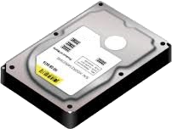
Cache
1,2,3,4,5
Thread.sleep(10000); x*x
1,4,9,16,25
x+1
2,5,10,17,26
cache/persist
Notes:
(Suppose working w/ slower to load RDD numerous times)
(Don’t want wait full load each time)
Cache/persist called on RDD created AFTER intensive portion
(Merely an instruction…lazy like transform)
(Except returns the RDD back instead of new one…so can use old or returned one)
(Different levels of caching)
Default is MEMORY
Also Disk, or a combination for failover
(Might wonder why disk, but think of case where algorithm is bottleneck)
(Cutting DAG at that point is better)
(Now execute code 1st time with cache…runs from start…)
And once hit cache, Stores output for future executions
And continues as it did before
NEXT: Run new transform against data

Slide 66
Cache
1,2,3,4,5
Thread.sleep(10000); x*x
1,4,9,16,25
x+3
4,7,12,19,28
cache/persist
Notes:
(Run new transform against data)
NOW, graph realizes can skip slower instructs & grabs cache directly
Beginning instructs remain only for fault tolerance
(If cache lost, then can recalc and recache)
Rest works normally
(RDD abstracted enough that it doesn’t care where data’s from)
(RDD is just an interface)
NEXT: See it in action

Slide 67
Let’s see it in action!
Notes:
NEXT: Final notes on caching

Slide 68
Cache
cache/persist
org.apache.spark.storage.StorageLevel.MEMORY_ONLY
persist(newLevel: StorageLevel)
MEMORY_ONLY
MEMORY_AND_DISK
DISK_ONLY
MEMORY_ONLY_SER
MEMORY_AND_DISK_SER
…_2
OFF_HEAP
unpersist(blocking: Boolean = true)
Notes:
(Now review different ways to cache)
Just saw cache…which is alias for persist
Both use default storage of MEMORY ONLY
(Works til full, then runs DAG as usual)
Persist accepts StorageLevel if want other than default
Number of options, we’ve seen MEMORY_ONLY
MEMORY_AND_DISK (Mem overflow to disk instead full execution)
DISK_ONLY, as sounds
If memory space an issue, can append _SER to mem options..serialize at perf cost
ALL options can append _2 to replicate cache
(Less need for full failure recomp; Scheduler can opt to use alt loc; then re-replicate)
OFF_HEAP (in mem off JVM; experimental in web docs NOT API…not quite hardened)
(Also a None, but is default for ANY RDD, so zero sum;;If want to unpersist)
Call unpersist (empty parent blocks execution until actually cleared, false to move on)
(not REQUIRED; cache clears self once out of scope, or by more recent RDD; LRU)
(NOTE: unpersist REQUIRES parens even if default or won’t compile)
(NOTE: Once marked and acted on, cannot reset without first unpersist)
NEXT: Accumulators blackout

Slide 69
Notes:
(Saw transform and acts)
(Suppose want track value only tangential to actual computation)
(ie. Errors, like misformatted data)
(Could return tuple w/ both vals…but is that code muddle?)
NEXT: No worries! Spark has Accumulators

Slide 70
Accumulator
val accumulator = sc.accumulator(0, “Accumulator Name”)
: Accumulator[Int]
rdd.foreach(x => {
doSomethingWith(x)
accumulator += 1
}
Action Methods
Worker Task
val accumulatedValue = accumulator.value
Driver
Notes:
(Shared variables for use across cluster)
(NOTE: another shared var broadcast…covered at end)
Accums are fairly simple…created by calling accum method on sc
(Accepts a zero, or identity value, and optional name used only for tracking purposes)
Returns accumulator of type matching identity
(Default supported: int, double, float, and long)
(Create own w/ contract,AccumulatorParam; follow Associative Property; why soon)
Take accumulator
And increment directly in RDD methods
After RDD complete, use accum’s value prop to extract final
Thus why has to be associative, additions can run in each worker and assoc combined
Creation and reading ONLY on driver
Writing ONLY in worker
NEXT: Only guaranteed accurate within actions due to fault tolerance

Slide 71
Accumulator
2
3
1
6
Notes:
(Only guaranteed accurate within actions due to fault tolerance)
(Suppose we add accumulator in transform and workers run…)
Passing values to driver combiner
BUT disaster before RDD fully completes & node already reported goes down
Spark cant track a dead node
SO spins up new worker, triggering RDD recreate AND new accumulation value
NEXT: Passed to driver again

Slide 72
Accumulator
2
3
1
6
8
Notes:
(Passed to driver again)
(Double count for that partition)
(Could even occur if RDD is cached and falls out due to LRU)
(Technically allowed in transforms but only suggested for approx debugging)
(NOTE: If transform, recall lazy, so if check before act; or never act, value = 0)
(Actions are final point, so can guarantee only once)
(Even if worker dies after send, already marked complete, won’t rerun)
NEXT: Due to limitations, limited usecases IMO

Slide 73
Accumulator
rdd.foreach(x=>{
try{
fn(x)
}
catch {
case _ => errorCounterAccumulator += 1
}
}
Notes:
(Due to limitations, limited usecases IMO)
Common scenario is to count # of errors during action
(Could put error threshold to decide whether to save results or fail)
NEXT: Java idiosyncracies

Slide 74
Notes:
(Lots Spark, still need address some language API diffs)
(Python mirrors Scala closely, albeit sometimes delayed)
(Performance downside, improved over time…DataFrames negates completely…cover soon)
NEXT: Java on other hand…

Slide 75
Java
JavaRDD.[INSERT METHOD OF CHOICE](
new Function<TIn, TOut>(){
public TOut call(TIn value){
//process(value) -> TOut
}
}
)
Notes:
(Java on the other hand)
(More verbose…at least better w/ Java 8 lambdas)
Here is java RDD calling a method
And w/o lambdas, must create anonymous inner class
(Example is common scenario: function param of certain type & outputs variable of certain type)
Implement method named “call” matching in and out types
(NOTE: can create a named class that extends the function class used)
NEXT: What are the available Function classes?

Slide 76
Java
Function<TIn, TOut>
TOut call(TIn value)
Function2<TIn1, TIn2, TOut>
TOut call(TIn1 value1, TIn2 value2)
Function3<TIn1, TIn2, TIn3, TOut>
TOut call(TIn1 value1, TIn2 value2,
TIn3 value3)
FlatMapFunction<TIn, TOut>
Iterable<TOut> call(TIn value)
FlatMapFunction2<TIn1, TIn2, TOut>
Iterable<TOut> call(TIn1 value1, TIn2 value2)
VoidFunction<TIn>
void call(TIn value)
PairFunction<TIn, TKey, TValue>
Tuple2<TKey, TValue> call(TIn value)
PairFlatMapFunction<TIn, TKey, TValue>
Iterable<Tuple2<TKey, TValue> call(TIn value)
org.apache.spark.api.java.function
Notes:
(What are the available Function classes?)
Already saw generic function, param certain type, output same/new type
Also Function2 & 3; numbers refer to input params for “call”
Flatmap function classes, same except returns Iterable of output type
VoidFunction used for methods with no return like foreach
Finish w/ pair function classes, same as counterparts except return Tuple2<Key,Value>
All and some others found in org.apache.spark.api.java.function
NEXT: Last big diff…java doesn’t have implicits (mapToPair)

Slide 77
Java
JavaPairRDD<TK, TV> mapToPair<TK, TV> (PairFunction<TIn, TK, TV>)
Notes:
(Java != implicits)
(Nor dynamic)
(Explicit classes that contain methods trying to use)
Like pair functions…explicitly create JavaPairRDD via mapToPair
(function returns row as pairs)
(Only way to access PairRDD Functions)
NEXT: Resources

Slide 78
Resources
RDD Research Paper
http://www.cs.berkeley.edu/~matei/papers/2012/nsdi_spark.pdf
Lambdas
What’s New in Java 8: Jose Paumard
Functional Programming With Java: Jessica Kerr
Add ALL the Things: Avi Bryant
http://www.infoq.com/presentations/abstract-algebra-analytics
Official Documentation
https://spark.apache.org/docs/latest/programming-guide.html
Python API: Josh Rosen
https://www.youtube.com/watch?v=xc7Lc8RA8wE
Notes:
Original RDD Research Paper
More on lambdas in Pluralsight
What’s New in Java 8
Functional Programming with Java
Add ALL the Things (Associativity, think clustering)
Official core documentation
Python API talk
NEXT: Summary/Questions

Slide 79
Summary
Spark Context
RDD
Transformations
Actions
Caching
Accumulators
Java
Notes:
Questions?

